Slide 1
An Introduction to Parallel Programming
Peter Pacheco
Chapter 3
Distributed Memory Programming with
MPI
Lecture 9
Copyright © 2010, Elsevier Inc. All rights Reserved
Notes:
The University of Adelaide, School of Computer Science
Chapter 2 — Instructions: Language of the Computer

Slide 2
Objectives
  Examine and understand the multiple ways to acquire input from the user
    Write more interactive programs
  Intro to collective communication
    MPI_Reduce and MPI_Bcast
      Let’s revisit the trapezoid (AGAIN)
      Comparison (This version vs MPI_Send/Recv version)
    MPI_AllReduce
10-<number>

Slide 3
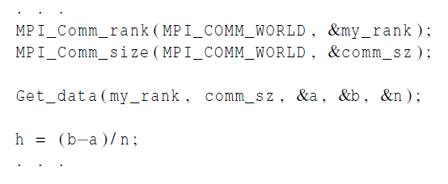
Input
Most MPI implementations only allow process 0 in MPI_COMM_WORLD access to stdin.
Process 0 must read the data (scanf) and send to the other processes.
Copyright © 2010, Elsevier Inc. All rights Reserved

Slide 4
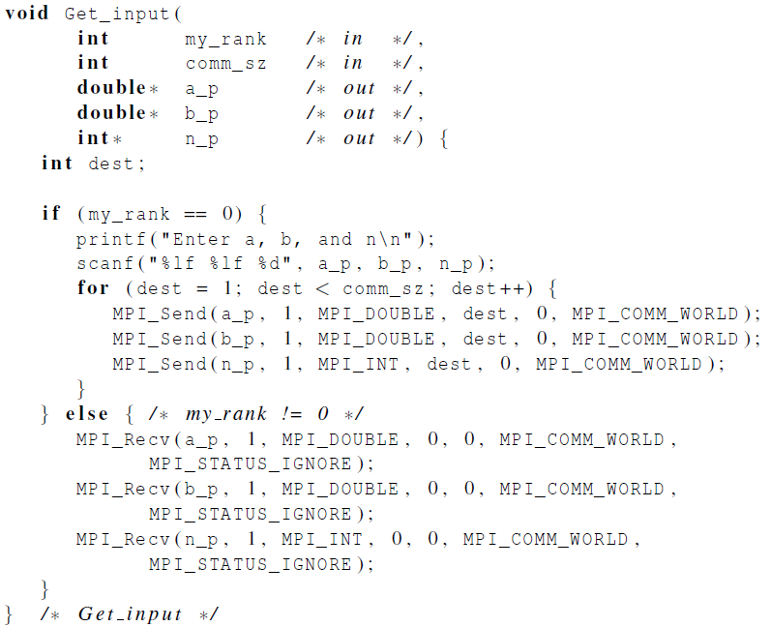
Function for reading user input
Copyright © 2010, Elsevier Inc. All rights Reserved

Slide 5
Lets look at some code
Example # 1 – Trapezoid V2
Example # 2 – Trapezoid V2 (Eduardo’s Input)
Before opening Example #2, see next slide
Copyright © 2010, Elsevier Inc. All rights Reserved

Slide 6
Lets look at some code
int main(void){…….}
CHECK THE DIFFERENCE
int main(int argc, char **argv) {…….}
What is this for ?, I have seen this 1000 times, Let’s use it
Copyright © 2010, Elsevier Inc. All rights Reserved

Slide 7

COLLECTIVE COMMUNICATION
Copyright © 2010, Elsevier Inc. All rights Reserved

Slide 8
Question
Can we have a better communication style/ Do we have more options available ?
Can we improve performance ?
Copyright © 2010, Elsevier Inc. All rights Reserved

Slide 9

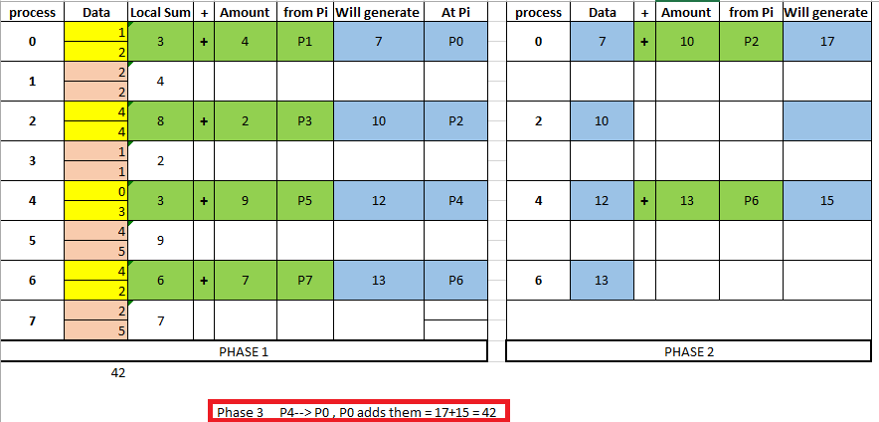
Imagine this
Copyright © 2010, Elsevier Inc. All rights Reserved

Slide 10
Tree-structured communication
In the first phase:
(a) Process 1 sends to 0, 3 sends to 2, 5 sends to 4, and 7 sends to 6.
(b) Processes 0, 2, 4, and 6 add in the received values.
(c) Processes 2 and 6 send their new values to processes 0 and 4, respectively.
(d) Processes 0 and 4 add the received values into their new values.
(a) Process 4 sends its newest value to process 0.
(b) Process 0 adds the received value to its newest value.
Copyright © 2010, Elsevier Inc. All rights Reserved

Slide 11
Tree-structured communication
Yes, it improves
Send_Recv Version:
1 receiving (P0)
7 sending (to same guy, more congestion, less concurrency)
Seven instants of time to capture data
This tree based version:
1 receiving
3 send phases
At t0: (P1→ P0), (P3→ P2), (P5, P4), (P7, P6)
At t1: (P2→ P0), (P6→ P4)
At t3: (P4→ P0)
7 instants of time VS 3 instant of time, implies a reduction in time of more than 50% , as N grows, it becomes even better
Copyright © 2010, Elsevier Inc. All rights Reserved

Slide 12
MPI_Reduce
The developer should know enough about HW and SW so that he/she can make better decision about implementation details
Designed to achieve better communication patterns
MPI_Send and MPI_Recv → Point to Point Communications
Collective Communications: communication FX that involve all processes in a communicator
Copyright © 2010, Elsevier Inc. All rights Reserved

Slide 13
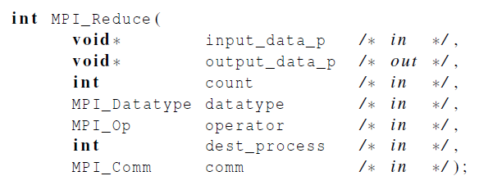
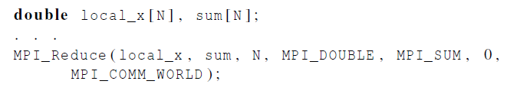
MPI_Reduce
Copyright © 2010, Elsevier Inc. All rights Reserved

Slide 14
MPI_Reduce
Executed by all processes in the communicator
The 5th argument (operator) is predefined (see table 3.2)
  It is possible to define my own operators? → YES
The 3rd operator (count)
  If = = 1: Then we are talking about a scalar
  If >1: then we are talking about an array
Copyright © 2010, Elsevier Inc. All rights Reserved

Slide 15
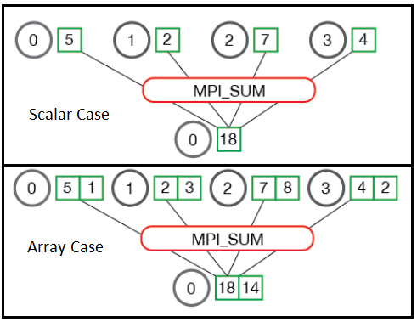
MPI_Reduce
Copyright © 2010, Elsevier Inc. All rights Reserved

Slide 16
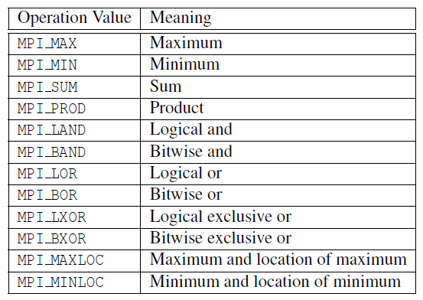
Predefined reduction operators in MPI
Copyright © 2010, Elsevier Inc. All rights Reserved

Slide 17
Collective vs. Point-to-Point Communications
ALL (AGAIN ALL) the processes in the communicator MUST call the same collective function.
For example, a program that attempts to match a call to MPI_Reduce on one process with a call to MPI_Recv on another process is erroneous, and, in all likelihood, the program will hang or crash.
Copyright © 2010, Elsevier Inc. All rights Reserved

Slide 18
Collective vs. Point-to-Point Communications
The arguments passed by each process to an MPI collective communication must be “compatible.”
For example, if one process passes in 0 as the dest_process and another passes in 1, then the outcome of a call to MPI_Reduce is erroneous, and, once again, the program is likely to hang or crash.
Copyright © 2010, Elsevier Inc. All rights Reserved

Slide 19
Collective vs. Point-to-Point Communications
The output_data_p argument is only used on dest_process.
However, ALL of the processes still need to pass in an actual argument corresponding to output_data_p, even if it’s just NULL.
Copyright © 2010, Elsevier Inc. All rights Reserved

Slide 20
Collective vs. Point-to-Point Communications
Point-to-point communications:
  Are matched on the basis of tags & communicators.
Collective communications:
  DO NOT use tags
  They’re matched solely on the basis of the communicator & the order in which they’re called.
Copyright © 2010, Elsevier Inc. All rights Reserved

Slide 21
Example (1)
The following conditions apply to this example
  All processes call reduce with MPI_SUM
  The destination process is P0
Copyright © 2010, Elsevier Inc. All rights Reserved

Slide 22
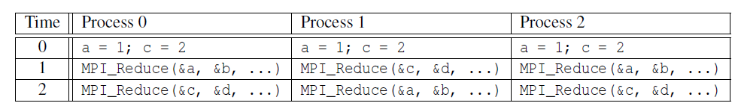
Example 1 (Slide 2)
Multiple calls to MPI_Reduce
Time | P0 | P1 | P2 |  | result
0
1 | a→b=1 | c→d=2 | a→b=1 | 1+2+1 | 4 = b
2 | c→d=2 | a→b=1 | c→d=2 | 2+1+2 | 5 = d
YES
Time | P0 | P1 | P2 | Result a | Result b
0
1 | a→b=1 | c→d=2 | a→b=1 | b = 2 | d = 2
2 | c→d=2 | a→b=1 | c→d=2 | b = 2+1=3 | d=2+2+2=6
NO
Copyright © 2010, Elsevier Inc. All rights Reserved

Slide 23
Example 1 (Slide 3)
Suppose that each process calls MPI_Reduce with operator MPI_SUM, and destination process 0.
At first glance, it might seem that after the two calls to MPI_Reduce, the value of b will be 3, and the value of d will be 6.
Copyright © 2010, Elsevier Inc. All rights Reserved

Slide 24
Example 1 (Slide 4)
However, the names of the memory locations are irrelevant to the matching of the calls to MPI_Reduce.
The order of the calls will determine the matching → so the value stored in b will be 1+2+1 = 4, and the value stored in d will be 2+1+2 = 5.
Copyright © 2010, Elsevier Inc. All rights Reserved

Slide 25
This is forbidden
This is illegal in MPI
It is known as aliasing
Aliasing: two arguments are aliased if they refer to the same block of memory (Remember this definition, a Good CS graduate will know this)
Consequences:
  It might produce and incorrect result
  It might cause the program to crash
  It might even produce a correct result
Copyright © 2010, Elsevier Inc. All rights Reserved

Slide 26
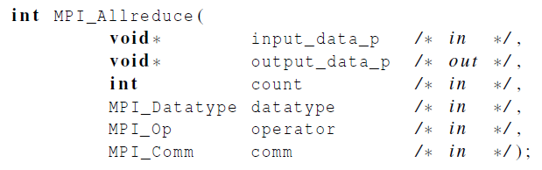
MPI_Allreduce
Useful in a situation in which ALL of the processes need the result of a global sum in order to complete some larger computation.
Format:
same as MPI_Reduce but there is NO dest_process
Copyright © 2010, Elsevier Inc. All rights Reserved

Slide 27
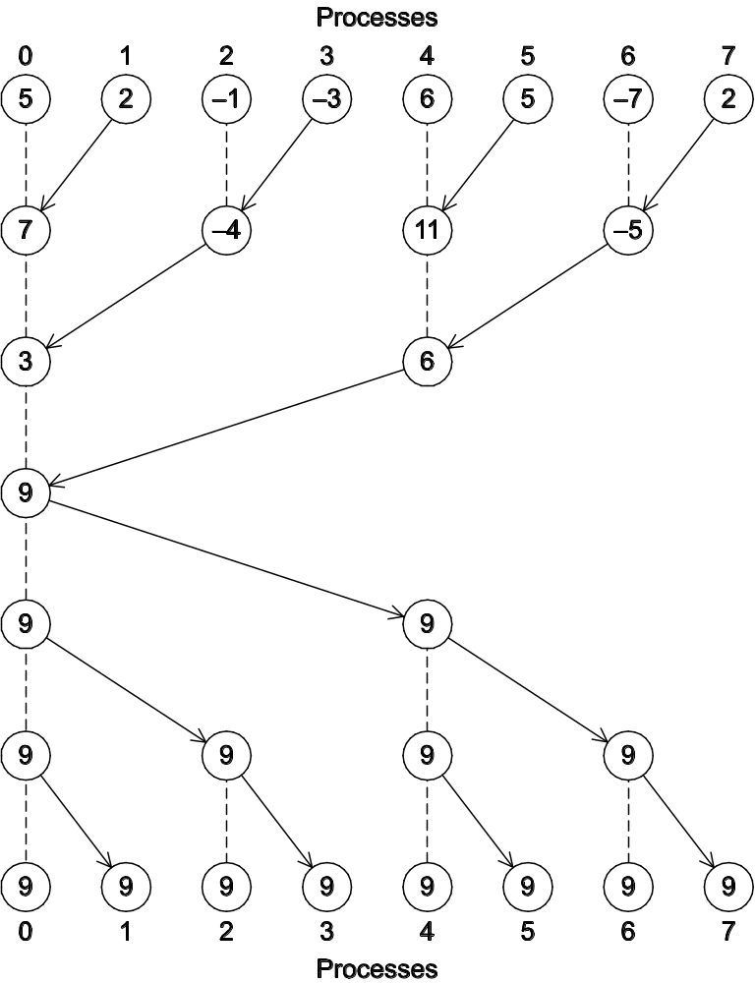
Communication Option # 1
A global sum followed
by distribution of the
result.
Not bad
Not necessarily the best
Six Instants of time
t0
t1
t2
t3
t4
t5
Copyright © 2010, Elsevier Inc. All rights Reserved

Slide 28

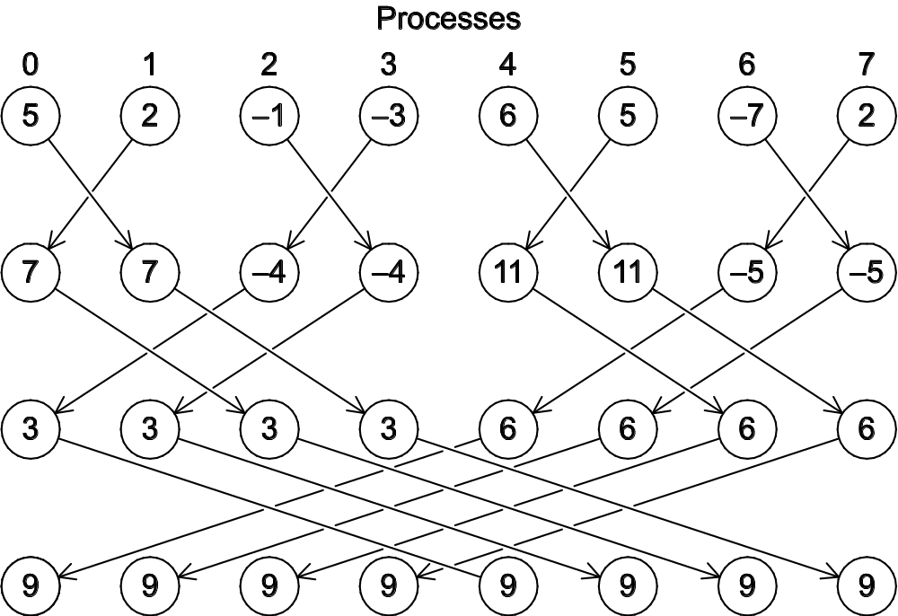
t0
t1
t2
A butterfly-structured global sum.
Copyright © 2010, Elsevier Inc. All rights Reserved

Slide 29
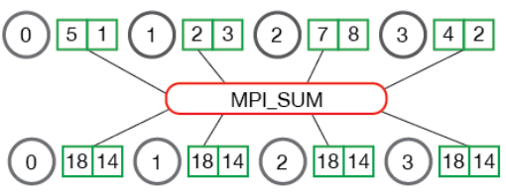
MPI_Allreduce
Copyright © 2010, Elsevier Inc. All rights Reserved

Slide 30
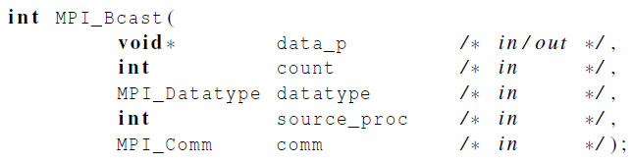
Broadcast
Used to distribute data
Think about a radio station
  They Broadcast something right?
Data belonging to a single process is sent to ALL of the processes in the communicator.
  We simply “reverse” the communication in the tree-structured global sum used in figure 3.6 to generate what you will see in figure 3.10
Copyright © 2010, Elsevier Inc. All rights Reserved

Slide 31
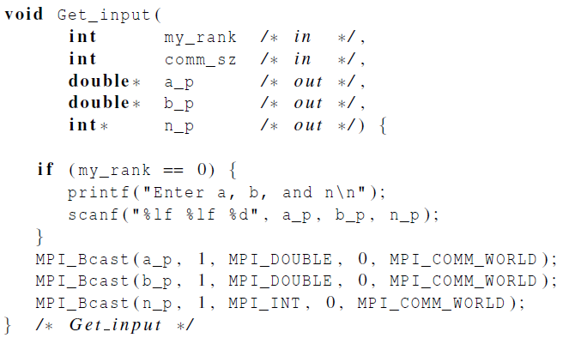
Broadcast
A collective communication in which data belonging to a SINGLE process is sent to all processes in the communicator is called broadcast.
It can be used in the trapezoid
Copyright © 2010, Elsevier Inc. All rights Reserved

Slide 32

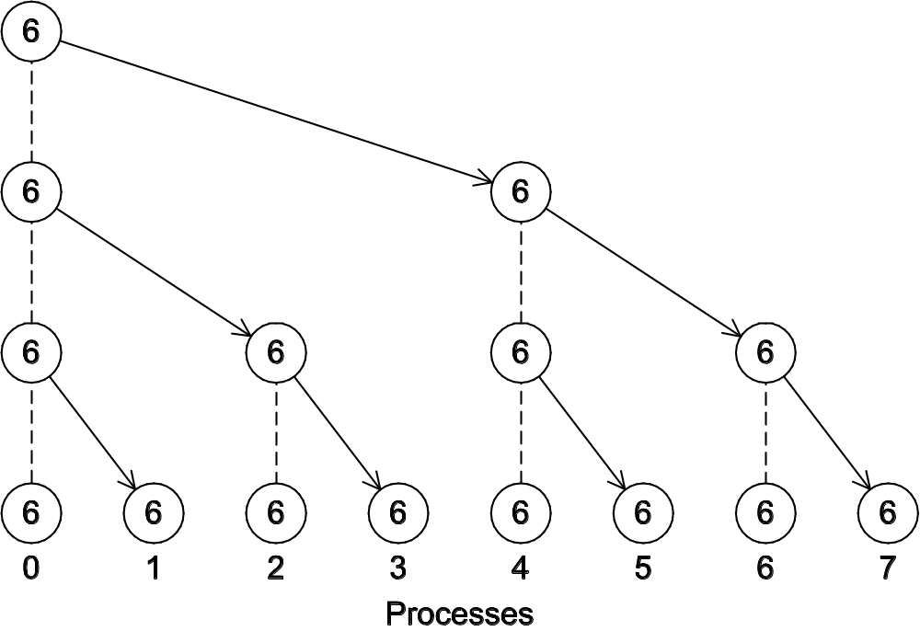
A tree-structured broadcast.
Copyright © 2010, Elsevier Inc. All rights Reserved

Slide 33
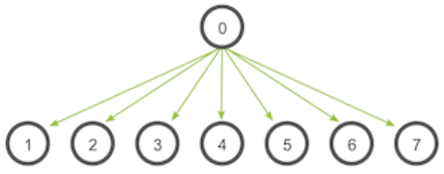
Broadcast
IDEA
Copyright © 2010, Elsevier Inc. All rights Reserved

Slide 34
Example
MPI_Reduce and MPI_Bcast
Copyright © 2010, Elsevier Inc. All rights Reserved
Notes:
The University of Adelaide, School of Computer Science
Chapter 2 — Instructions: Language of the Computer

Slide 35
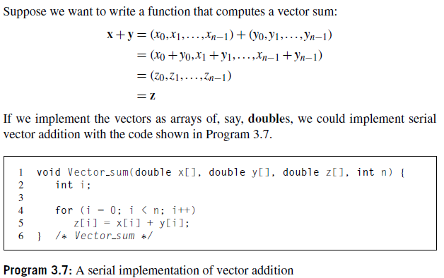
3.4.6 DATA DISTRIBUTIONS
Copyright © 2010, Elsevier Inc. All rights Reserved

Slide 36
3.4.6 DATA DISTRIBUTIONS
Copyright © 2010, Elsevier Inc. All rights Reserved

Slide 37
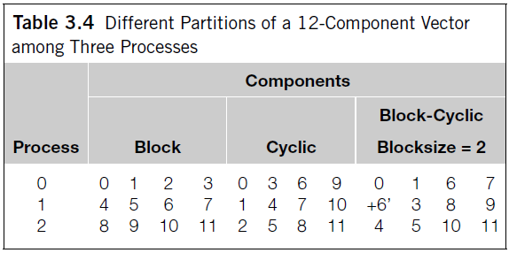
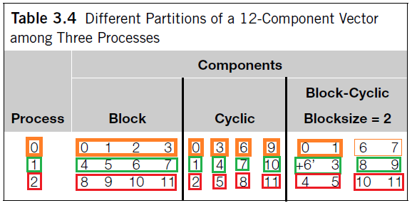
3.4.6 DATA DISTRIBUTIONS
Definitions for each one:
Pag 110.
Copyright © 2010, Elsevier Inc. All rights Reserved

Slide 38
Quiz
Next Class ()
This is a closed notes, closed book quiz. No computer will be required. Read your slides and make sure that you understand the material.
NO C programming, Yes MPI programming
Everything, specially the last lectures
Copyright © 2010, Elsevier Inc. All rights Reserved

